Slide 1
Convex Optimization: Geometric Programming
course project by
DMITRII GUREV
M03-201
Optimization in Machine Learning,
Fall 2022

Slide 2
Table of contents
Geometric Programming
- Monomials and posynomials
- Geometric program
- Convex optimization problem
- Geometric program in convex form
- Applications
- Current state of the art
Examples
- Frobenius norm diagonal scaling
- Maximum area of a rectangle
- Design of a cantilever beam

Slide 3
Geometric
Programming

Slide 4
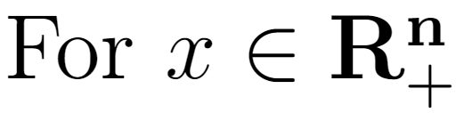
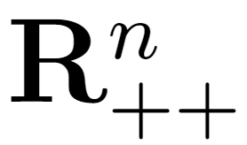
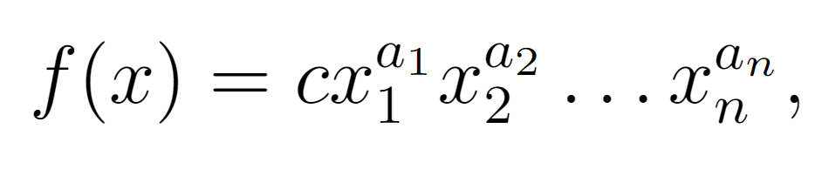
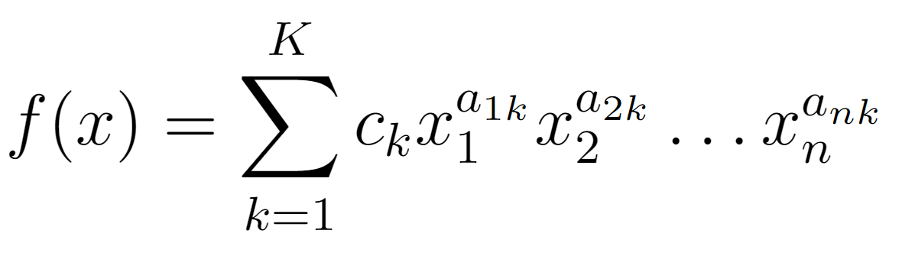
Monomials and posynomials
Monomial:
Posynomial:
with c > 0
with ck > 0

Slide 5
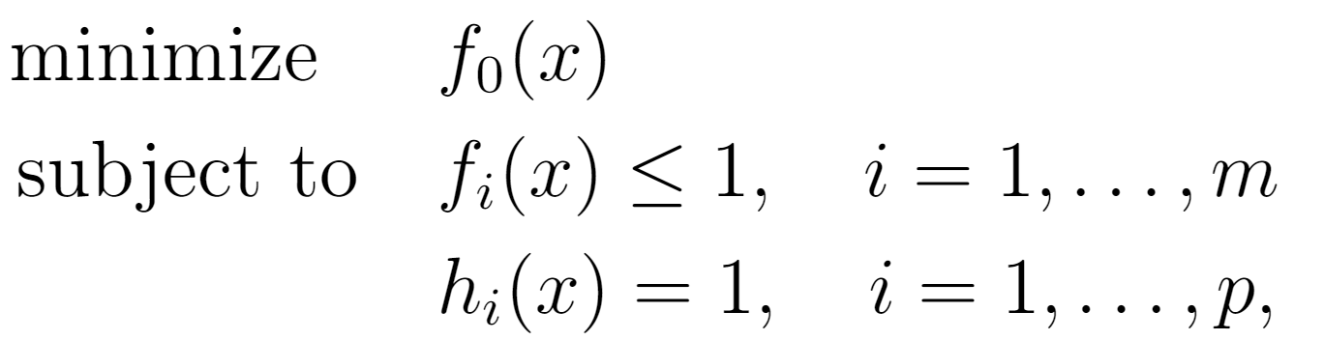
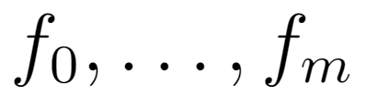
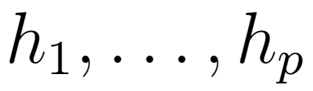
Geometric program
where are posynomials and are monomials

Slide 6
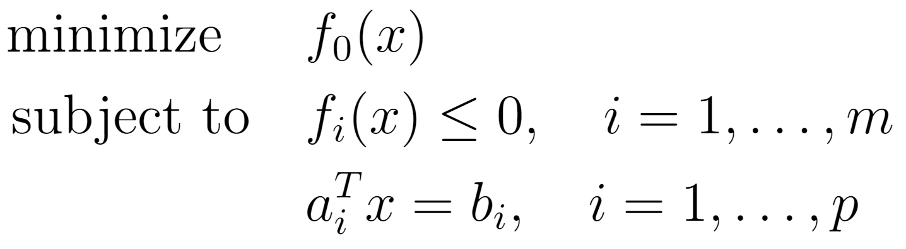
Convex optimization problem
where are convex functions

Slide 7

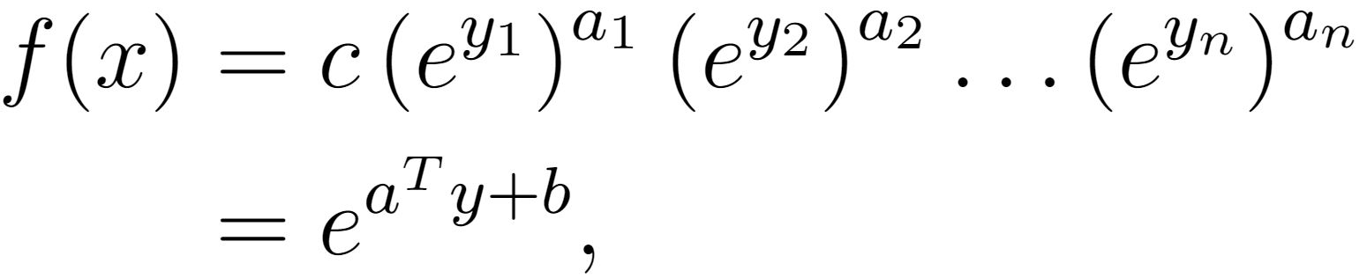
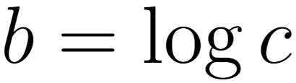
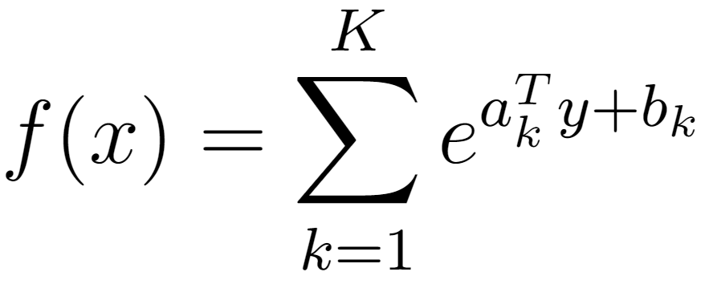
Geometric program in convex form
Change of variables:
Monomial:
Posynomial:

Slide 8
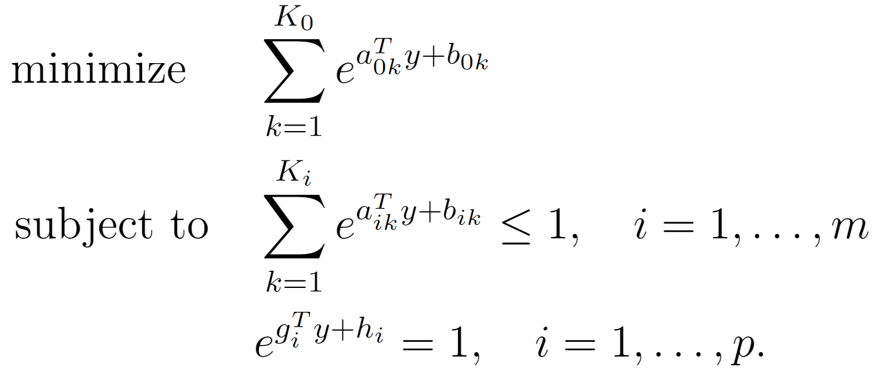
Geometric program in convex form

Slide 9
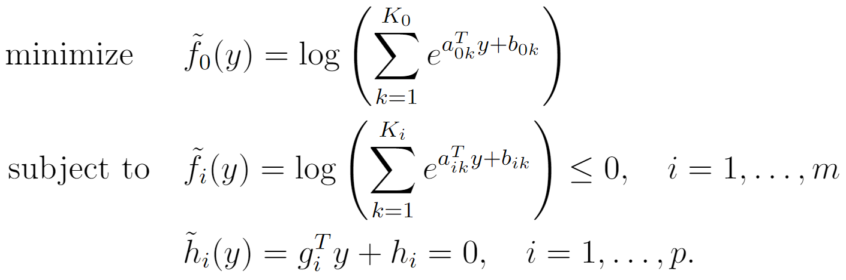
Geometric program in convex form

Slide 10
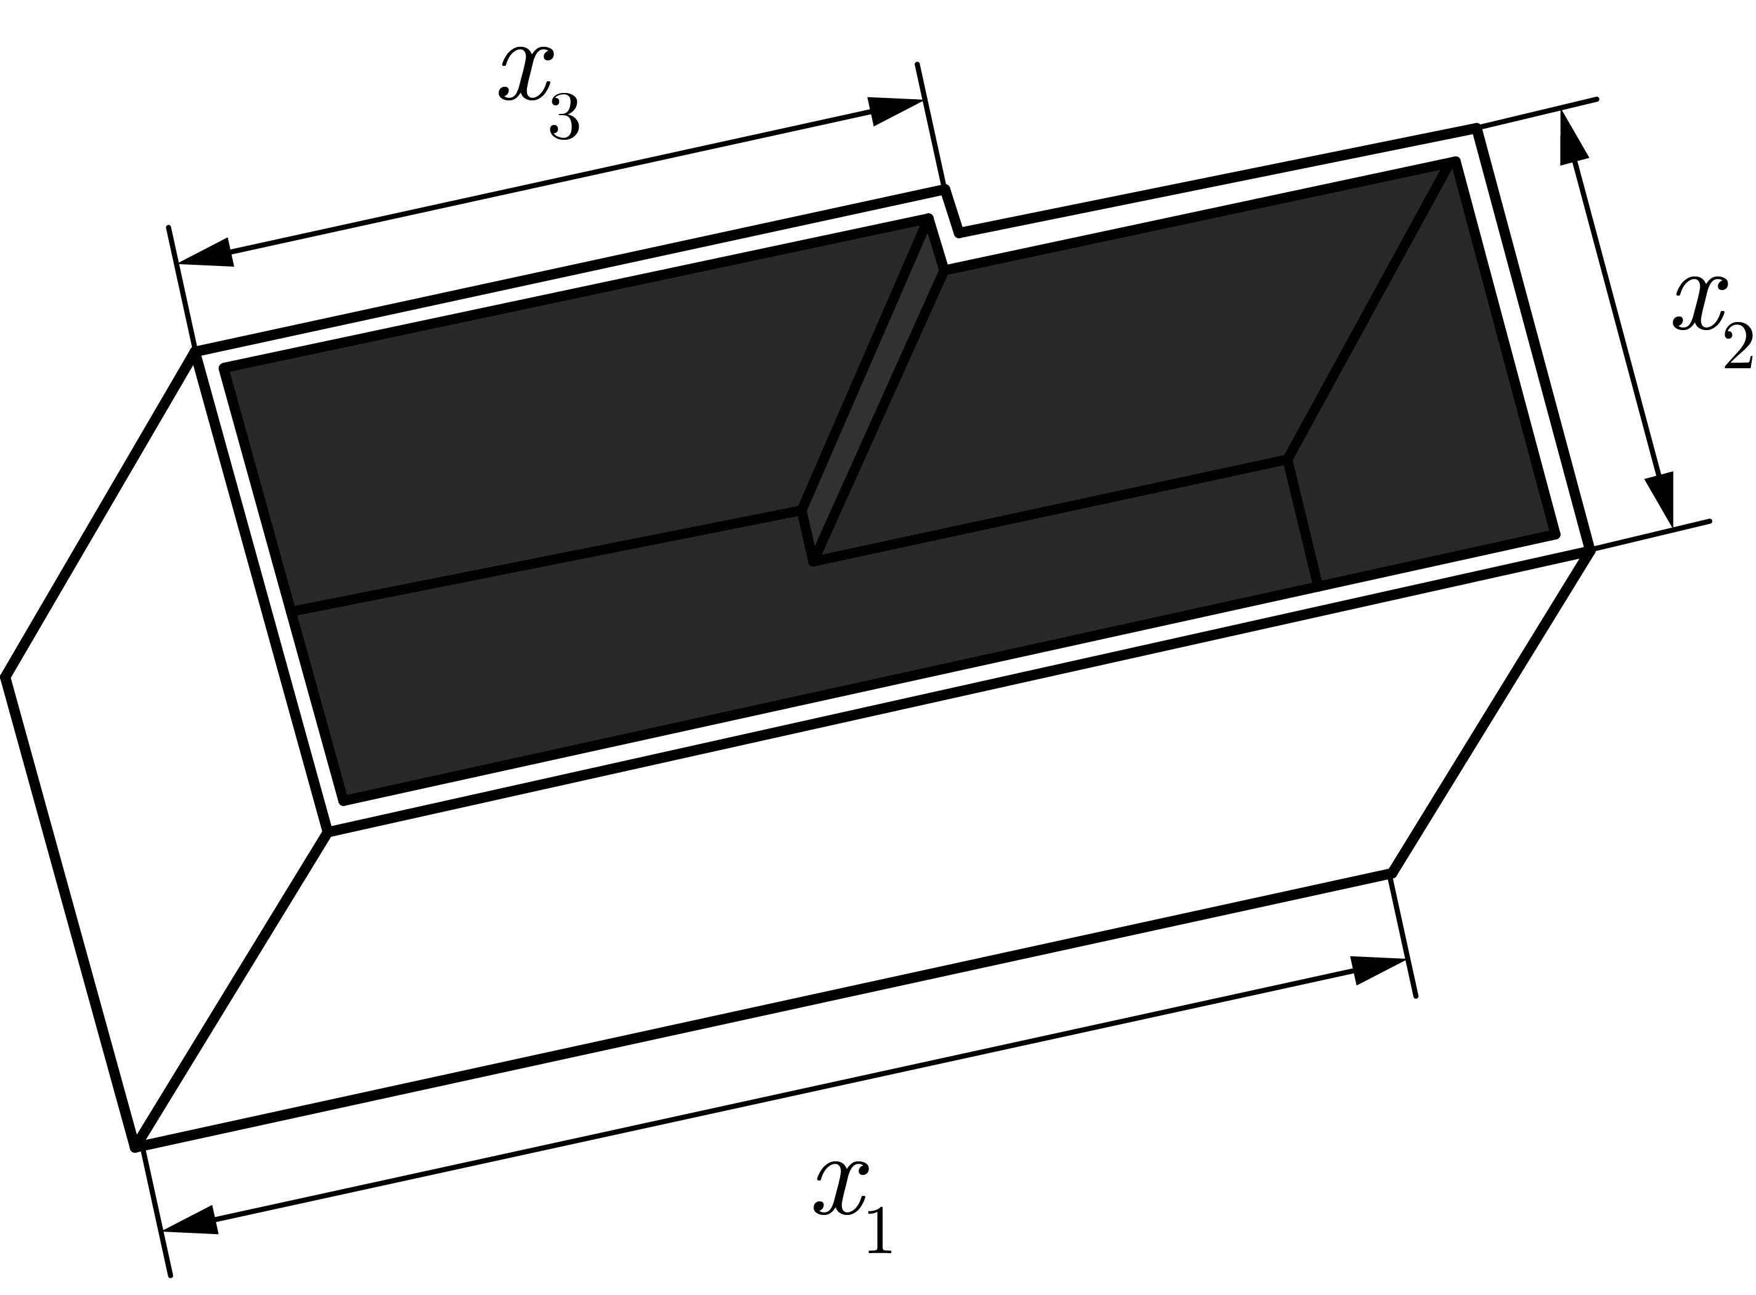
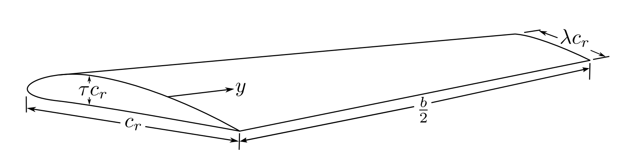
Applications
Component sizing
Aircraft design
Huang, Chia-Hui. "Engineering design by geometric programming." Mathematical problems in engineering 2013 (2013).
Hoburg, Warren, and Pieter Abbeel. "Geometric programming for aircraft design optimization." AIAA Journal 52.11 (2014): 2414-2426.

Slide 11
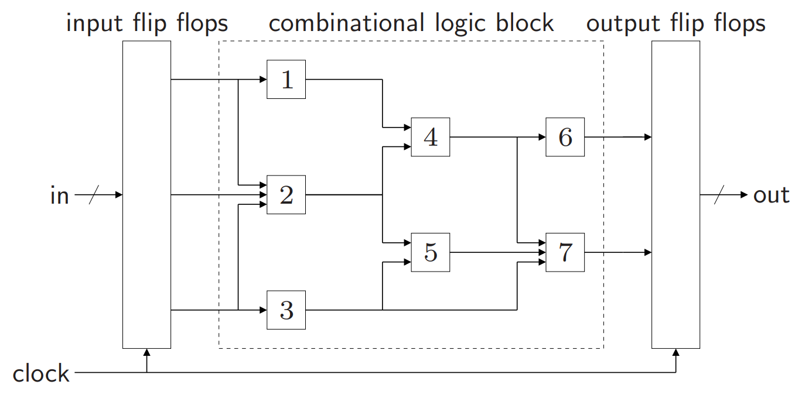
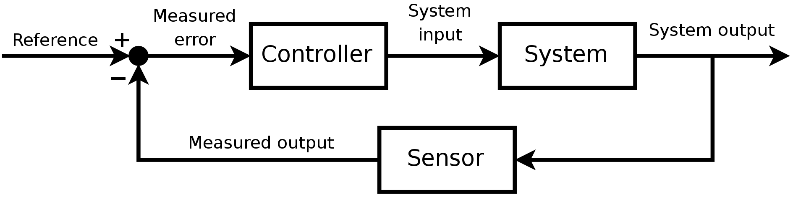
Applications
Electronic circuit design
Optimal control
Boyd, Stephen, Seung Jean Kim, and S. Mohan. "Geometric programming and its applications to EDA problems." date tutorial (2005).
Jefferson, T. R., and C. H. Scott. "Generalized geometric programming applied to problems of optimal control: I. Theory." Journal of Optimization Theory and Applications 26.1 (1978): 117-129.

Slide 12
Current state of the art
Interior-point methods (e.g. barrier method)
Approaching efficiency of linear programming solvers:
- 1,000 variables, 10,000 monomial terms: few seconds
- 10,000 variables, 100,000 monomial terms: minute
- 1,000,000 variables, 10,000,000 monomial terms: hour
these are order-of-magnitude estimates, on simple PC
Boyd, Stephen, Seung Jean Kim, and S. Mohan. "Geometric programming and its applications to EDA problems." date tutorial (2005).

Slide 13
Examples

Slide 14


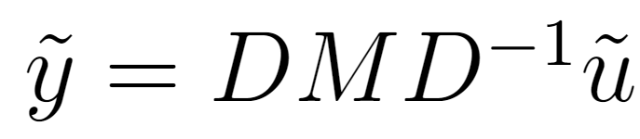
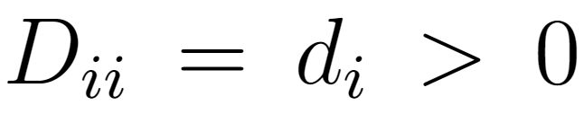

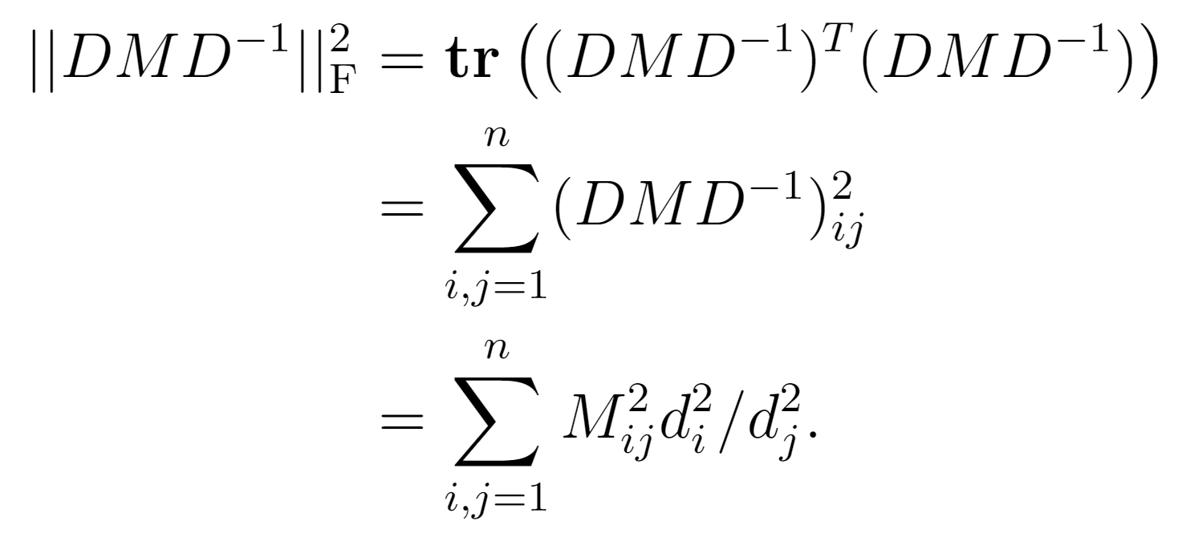
Frobenius norm diagonal scaling
Linear function
Scaling
D is a diagonal matrix with

Slide 15
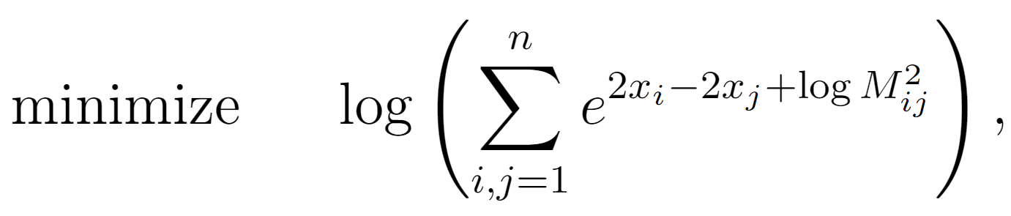

Frobenius norm diagonal scaling
In convex form:

Slide 16
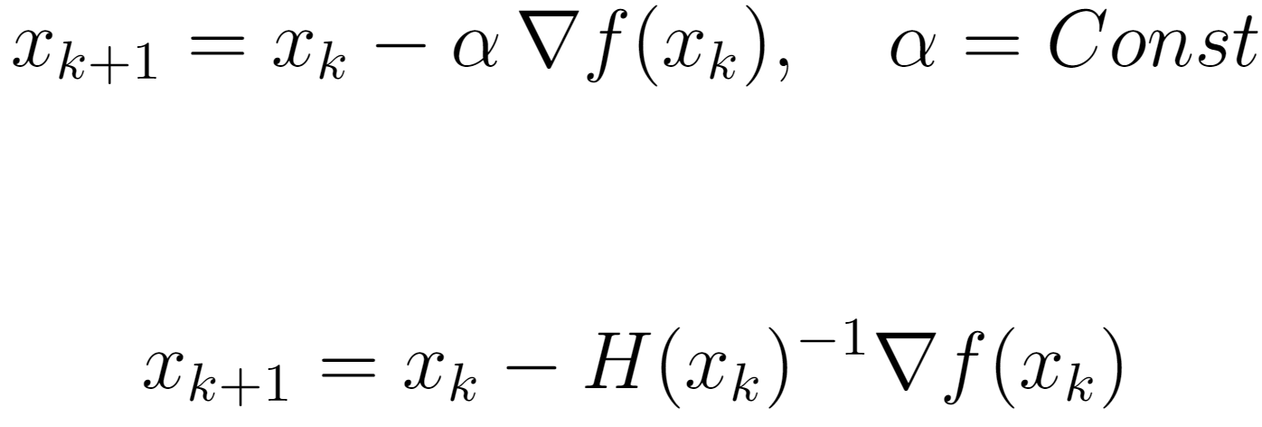
Frobenius norm diagonal scaling
Gradient descent:
Newton’s method:

Slide 17
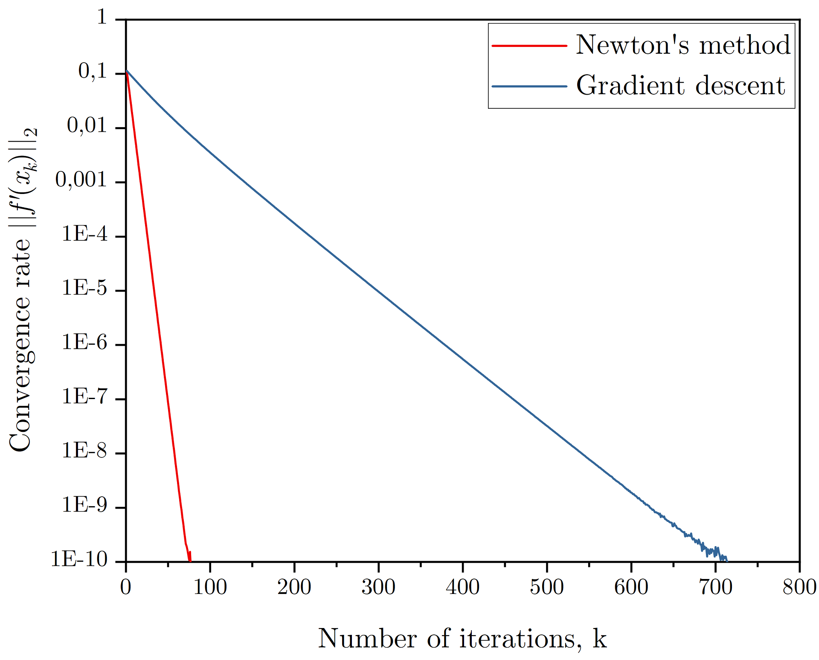
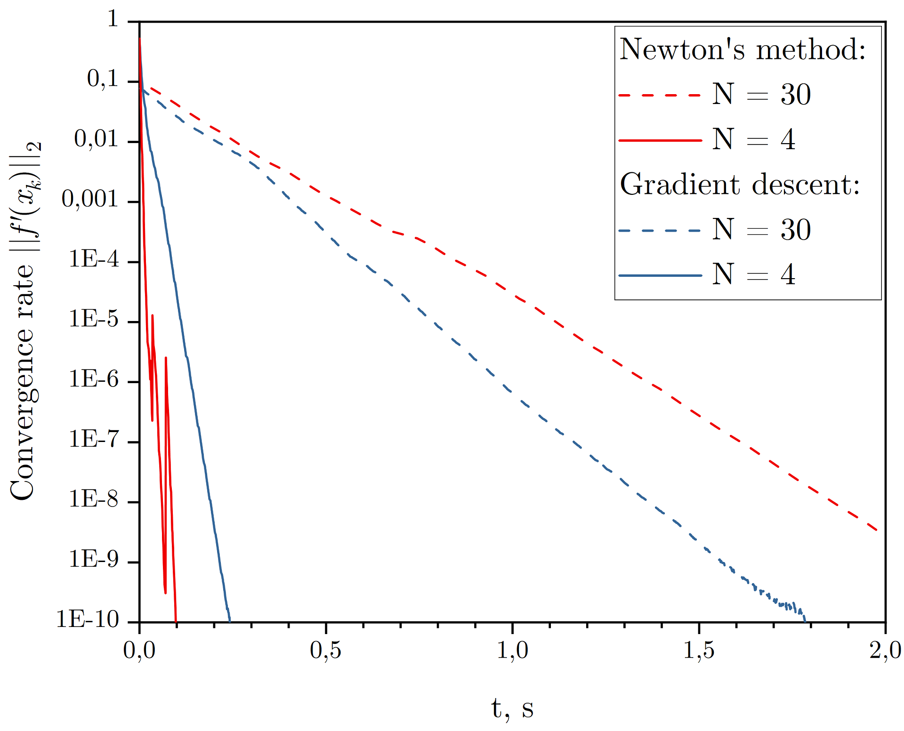
Frobenius norm diagonal scaling

Slide 18
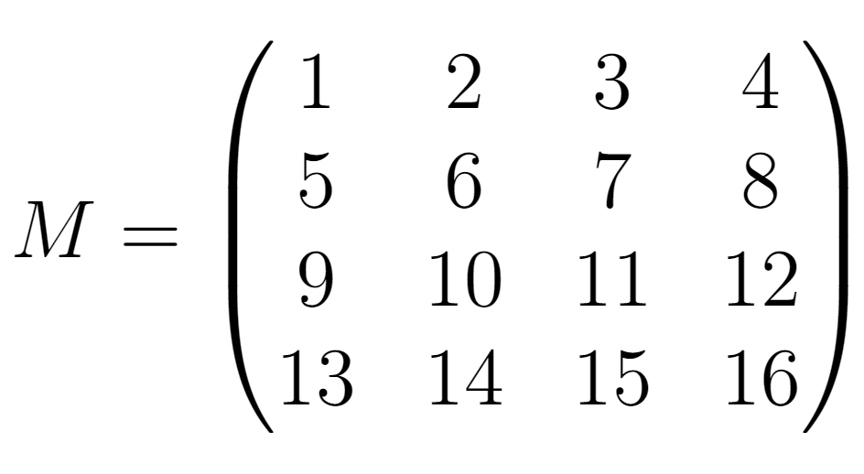
Frobenius norm diagonal scaling
For
the solution obtained is

Slide 19
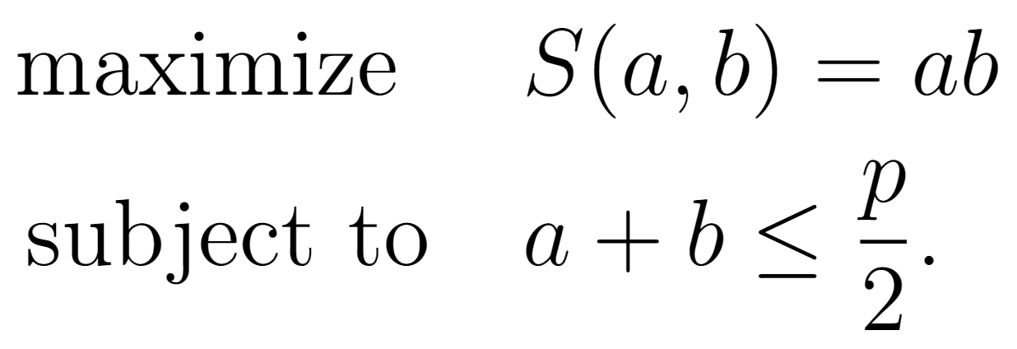
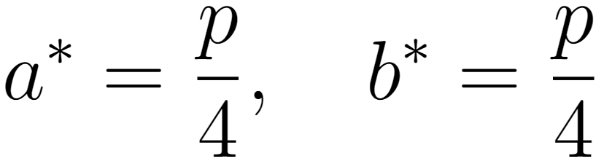
Maximum area of a rectangle
The solution is well known:

Slide 20
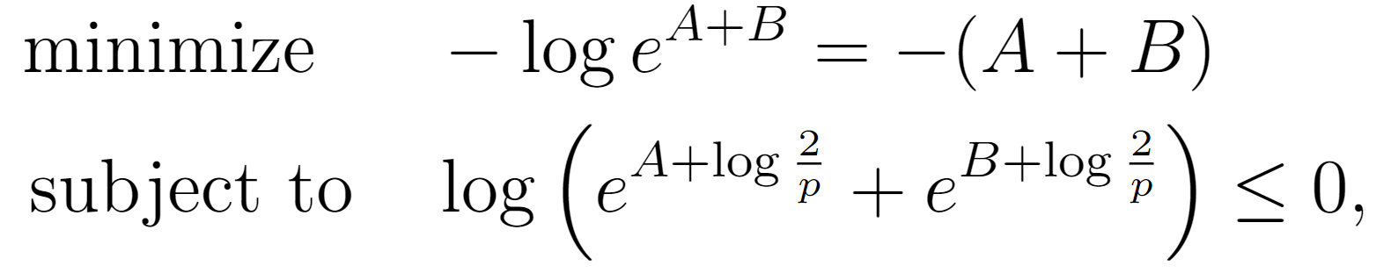
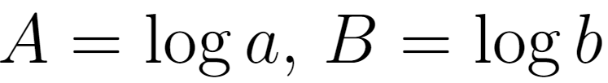
Maximum area of a rectangle
In convex form:

Slide 21
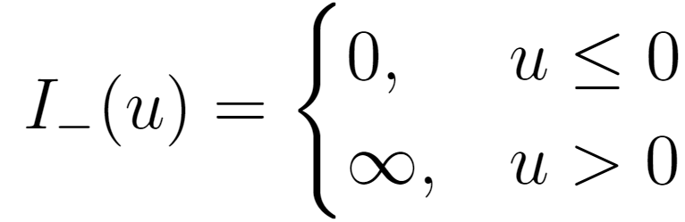
Maximum area of a rectangle
Use the barrier method to eliminate the inequality constraint:
Indicator function

Slide 22
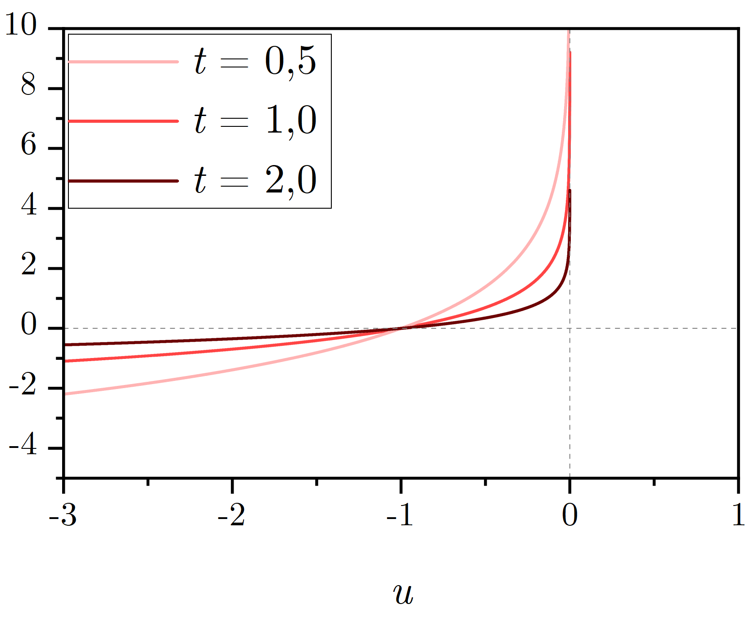
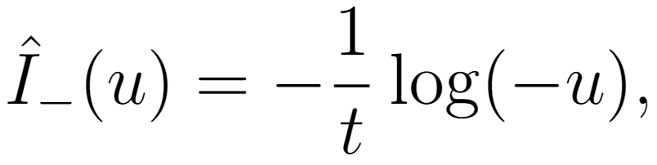
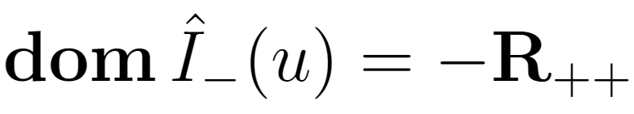
Maximum area of a rectangle
Logarithmic barrier is a differentiable approximation of the indicator function

Slide 23
Maximum area of a rectangle
Now the objective is to
(merely an approximation of the original problem)

Slide 24
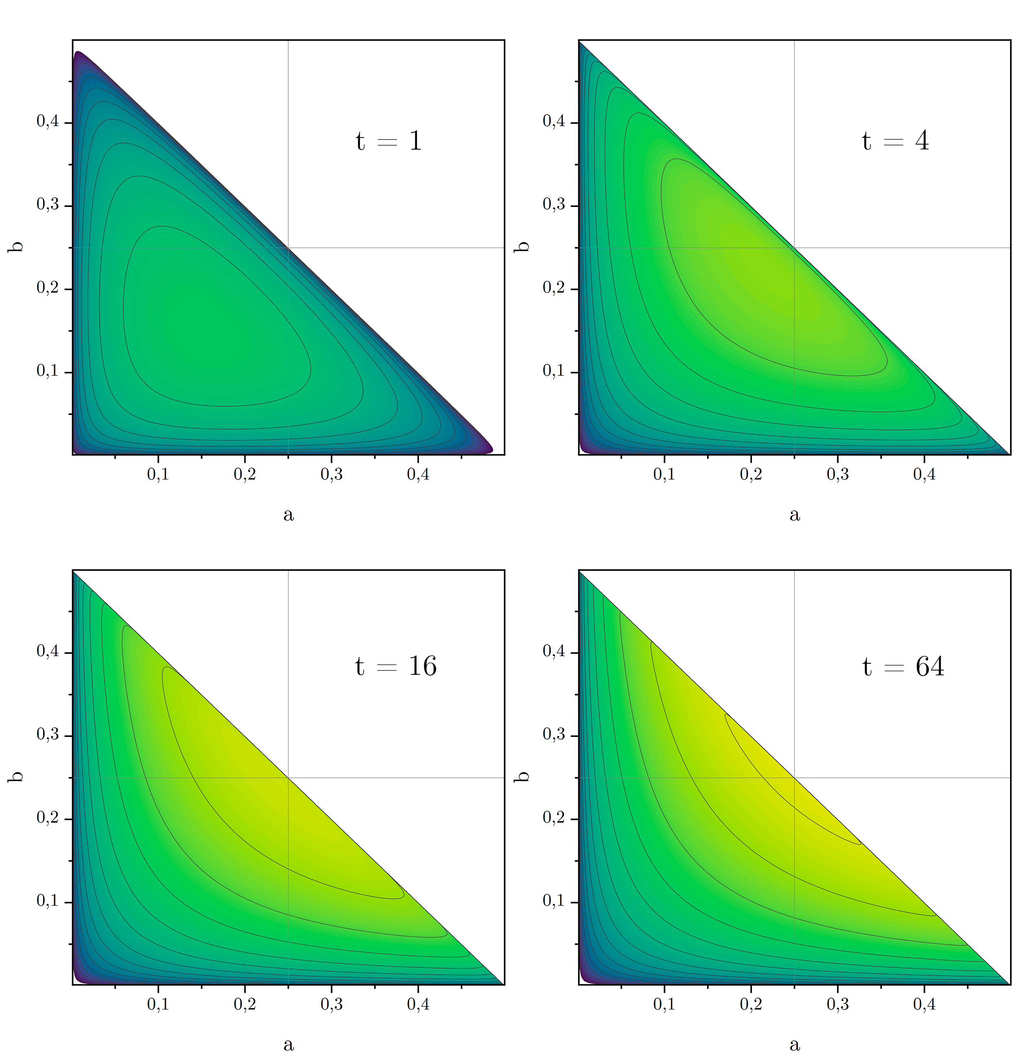
Maximum area of a rectangle
Solve a sequence of problems, increasing the parameter t (and therefore the accuracy of the approximation) at each step.

Slide 25
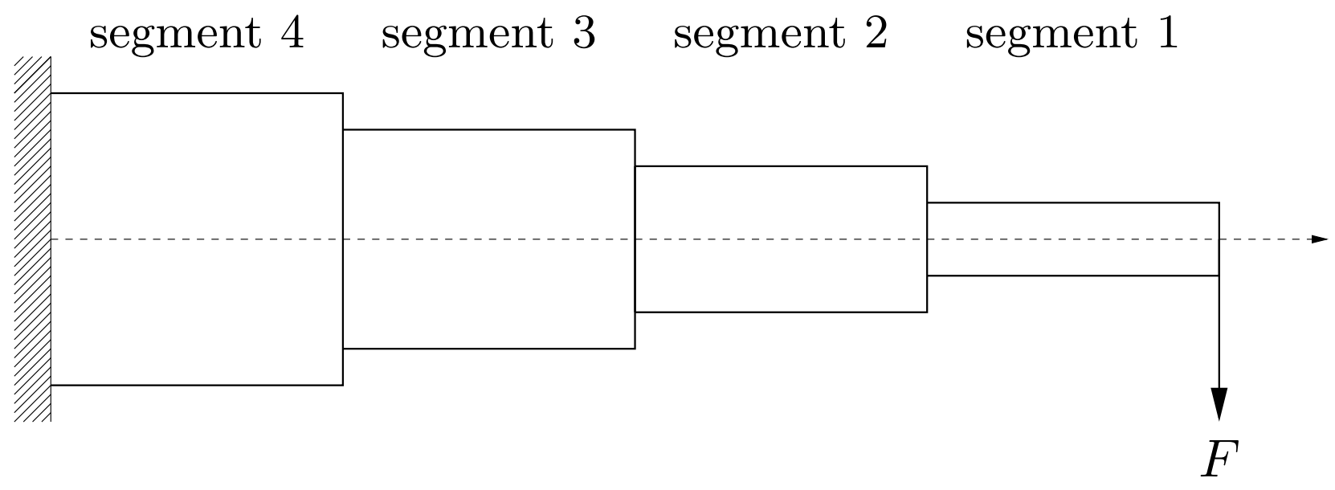

Design of a cantilever beam
N segments of a unit length, width wi and height hi
Minimize the volume

Slide 26
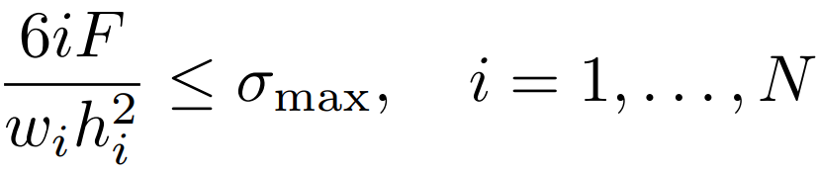

Design of a cantilever beam
Constraints:
maximum stress
maximum vertical deflection

Slide 27
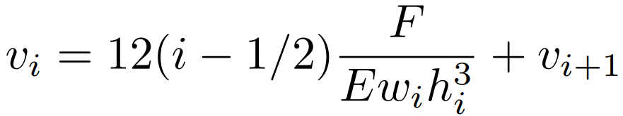
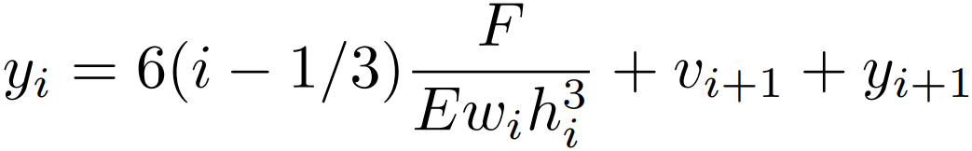

Design of a cantilever beam
The deflection can be found recursively
slope
deflection

Slide 28
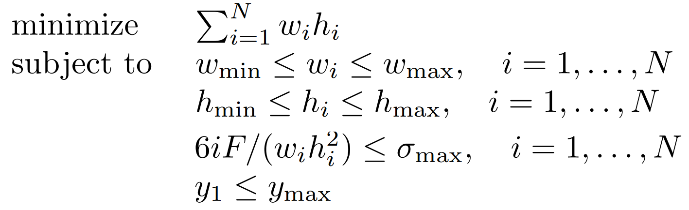
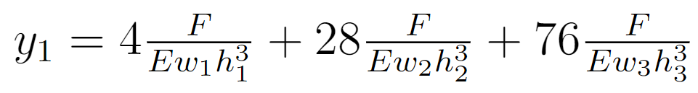
Design of a cantilever beam
For a 3-segment beam
The convex form can be derived analogously to the previous examples

Slide 29
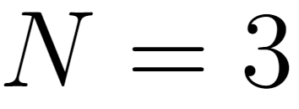
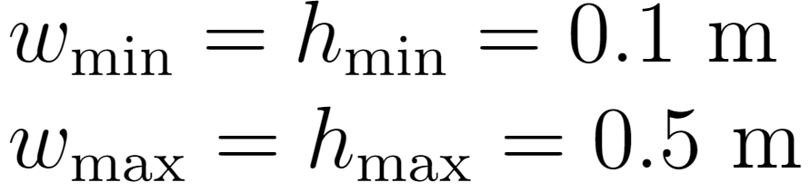
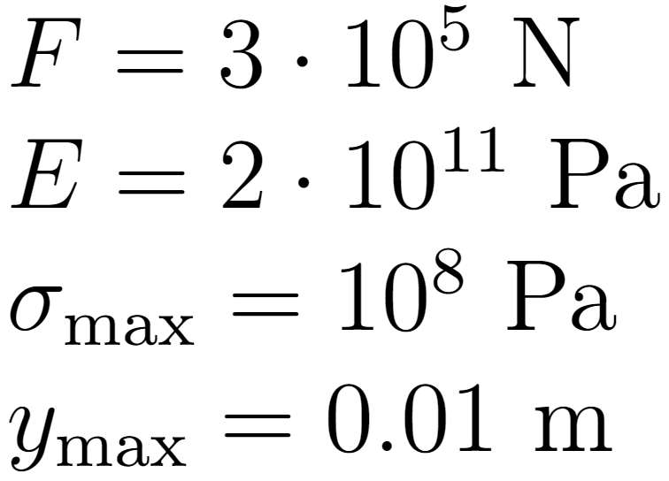
Design of a cantilever beam
Suppose
(steel)
(steel)

Slide 30
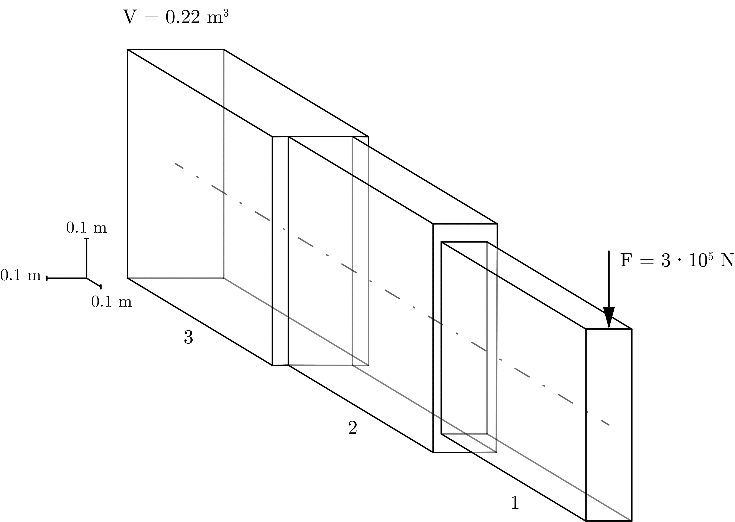
Design of a cantilever beam
The optimal volume is 0.22 m
3

Slide 31
Conclusions

Slide 32
Conclusions
Geometric programming
- comes up in a variety of contexts
- can be transformed to convex problems by a change of variables and a transformation of the objective and constraint functions
- admits fast, reliable solution of large-scale problems

Slide 33
Conclusions
Using Newton’s method with the barrier method for eliminating inequality constraints, the following illustrative problems have been solved:
- Frobenius norm diagonal scaling
- Maximum area of a rectangle
- Design of a cantilever beam

